Slide 1

Data Acquisition Info Presentation

Slide 2
Data Acquisition Info
What is GT Off-Road
What is Data Acquisition (DAQ)
What does DAQ do
What will I do in DAQ
What is expected of members in DAQ
How to join

Slide 3
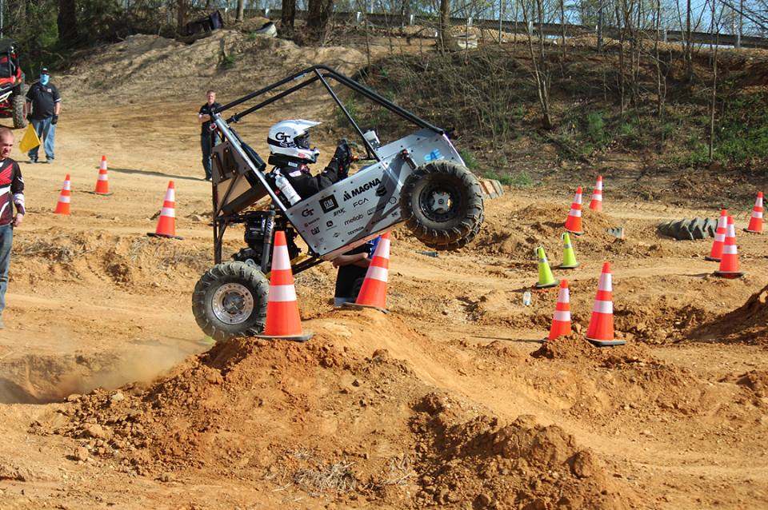
What is GT Off-Road?
Student led organization which designs, builds, and competes single seat off-road vehicles
Completely student run
Built from the ground up
Small automotive business design environment
Compete against over 200+ colleges

Slide 4
What is GT Off-Road?
Team Lead
Chief Engineer
Business Lead
Vehicle Dynamics Lead
Chassis Lead
Suspension Lead
Drivetrain Lead
Driver Controls Lead
Manufacturing Lead
Data Acquisition Lead
Vehicle Dynamics Team
Chassis Team
Drivetrain Team
Shop Manager
Suspension Team
Manufacturing Team
Finance Lead
Marketing Lead
Sponsor Relations Lead
Finance Team
Marketing Team
Driver Controls Team
Data Acquisition Team
Sponsor Relations Team

Slide 5
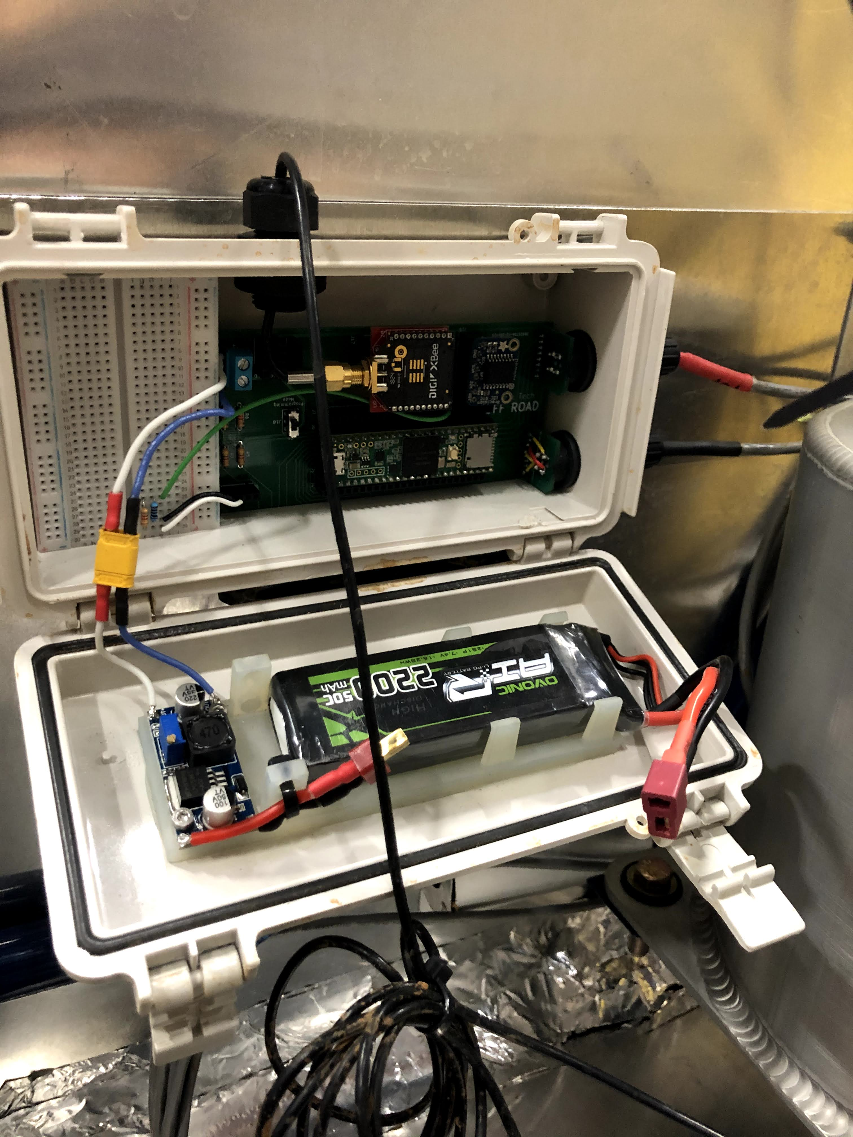
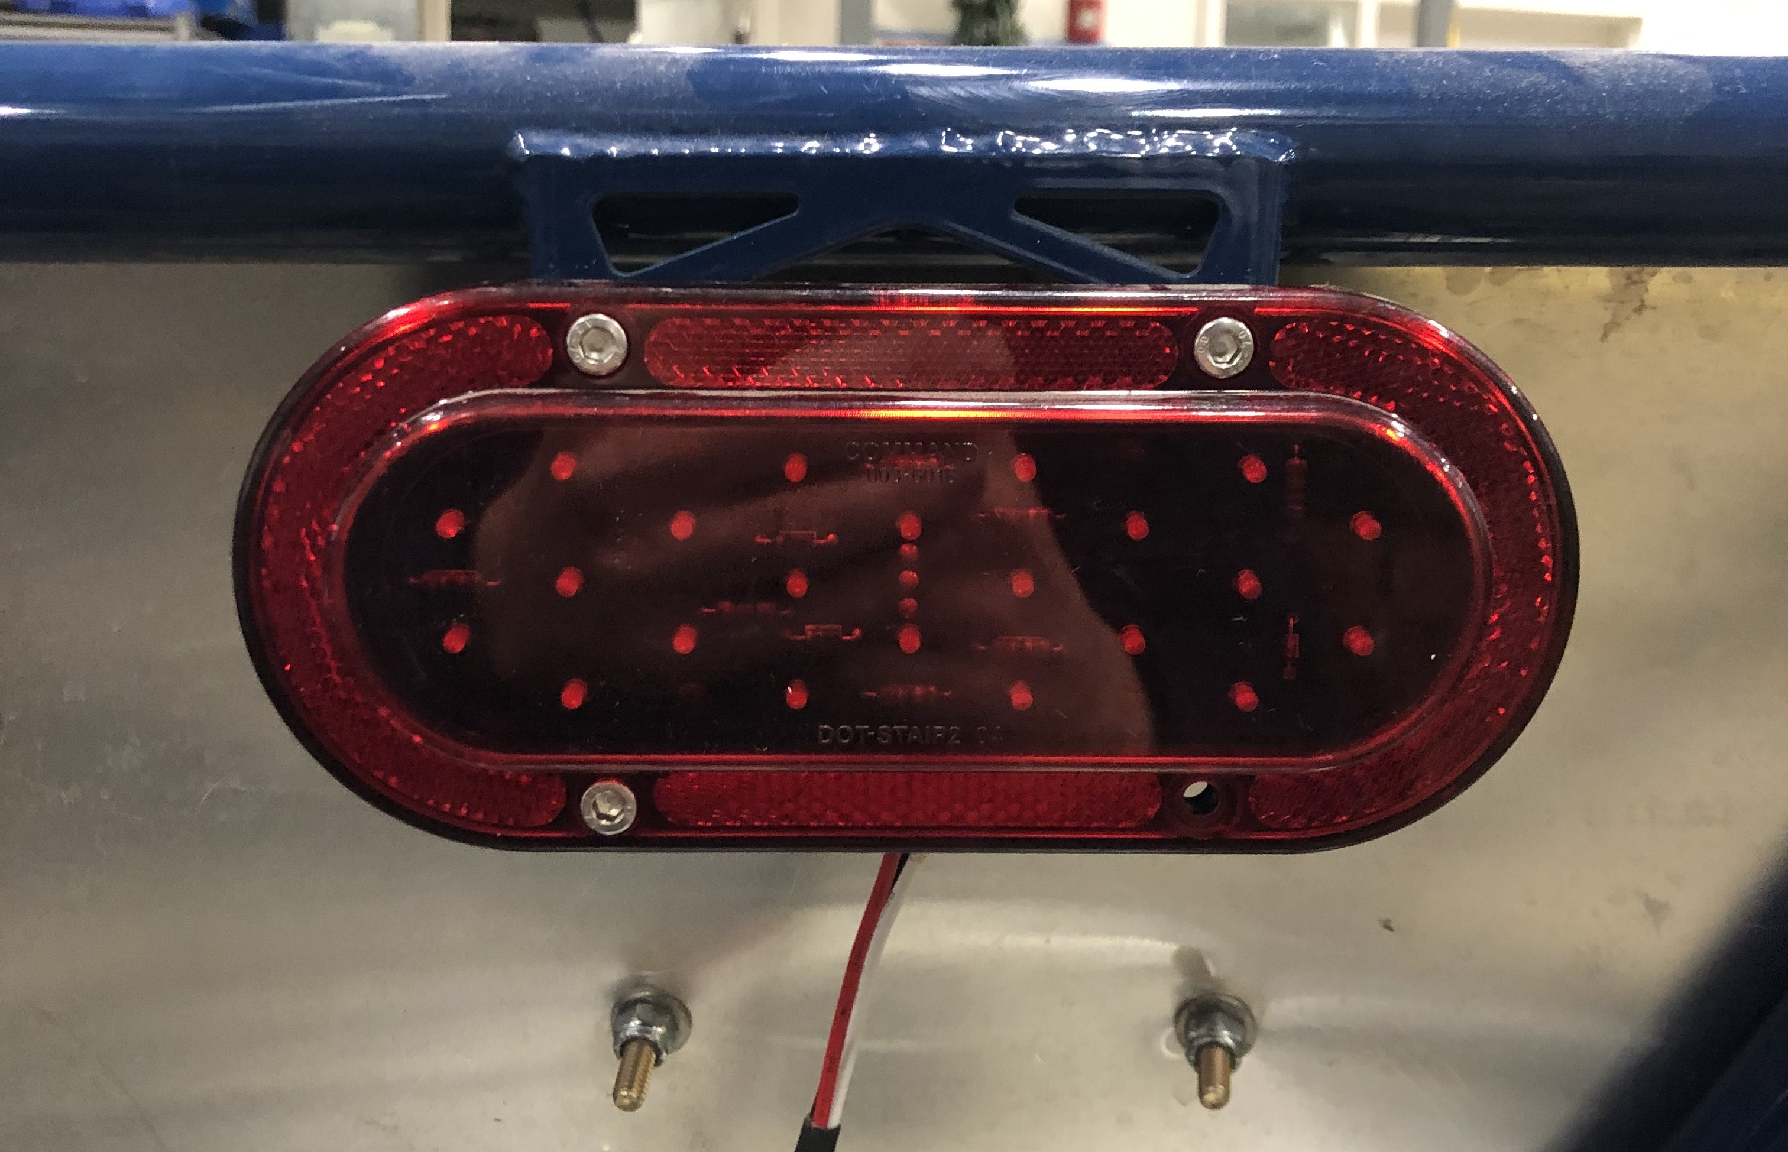
What is Data Acquisition?
Electrical and software design
Data collection
Test and experiment design

Slide 6
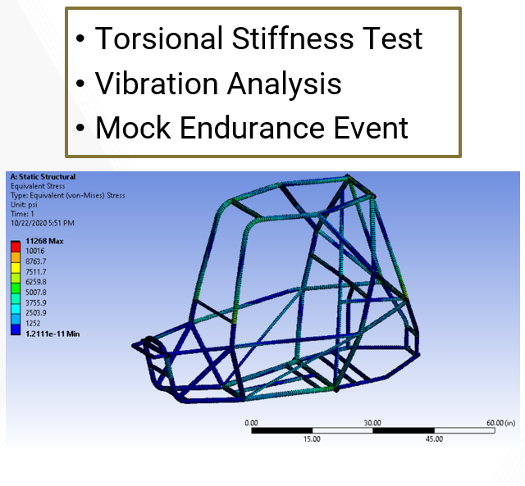
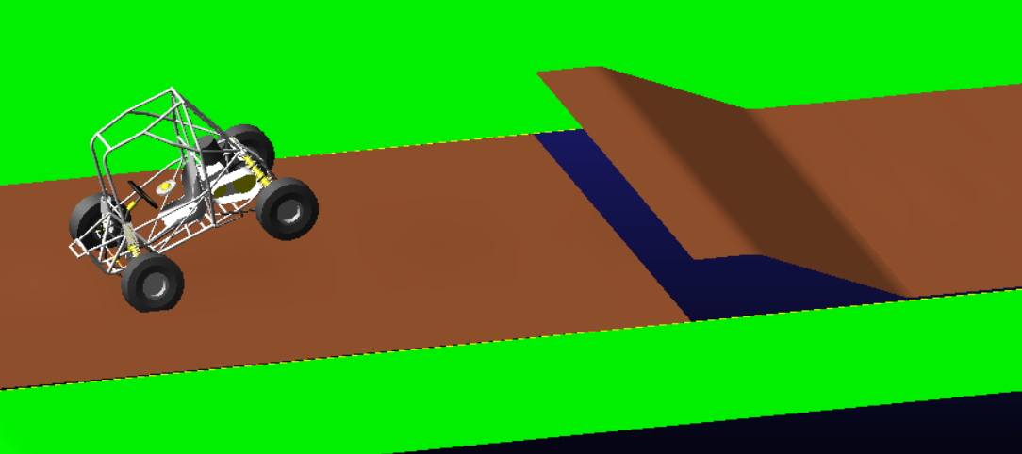
DAQ Purpose
Create load cases to be used for component design
Validate simulations and vehicle dynamics

Slide 7
What makes up daq?
Electrical Design
PCB Design
Embedded Design (C++)
Software Design (Python)
Data Analysis
Enclosure Design
Testing Rig Design
More!

Slide 8
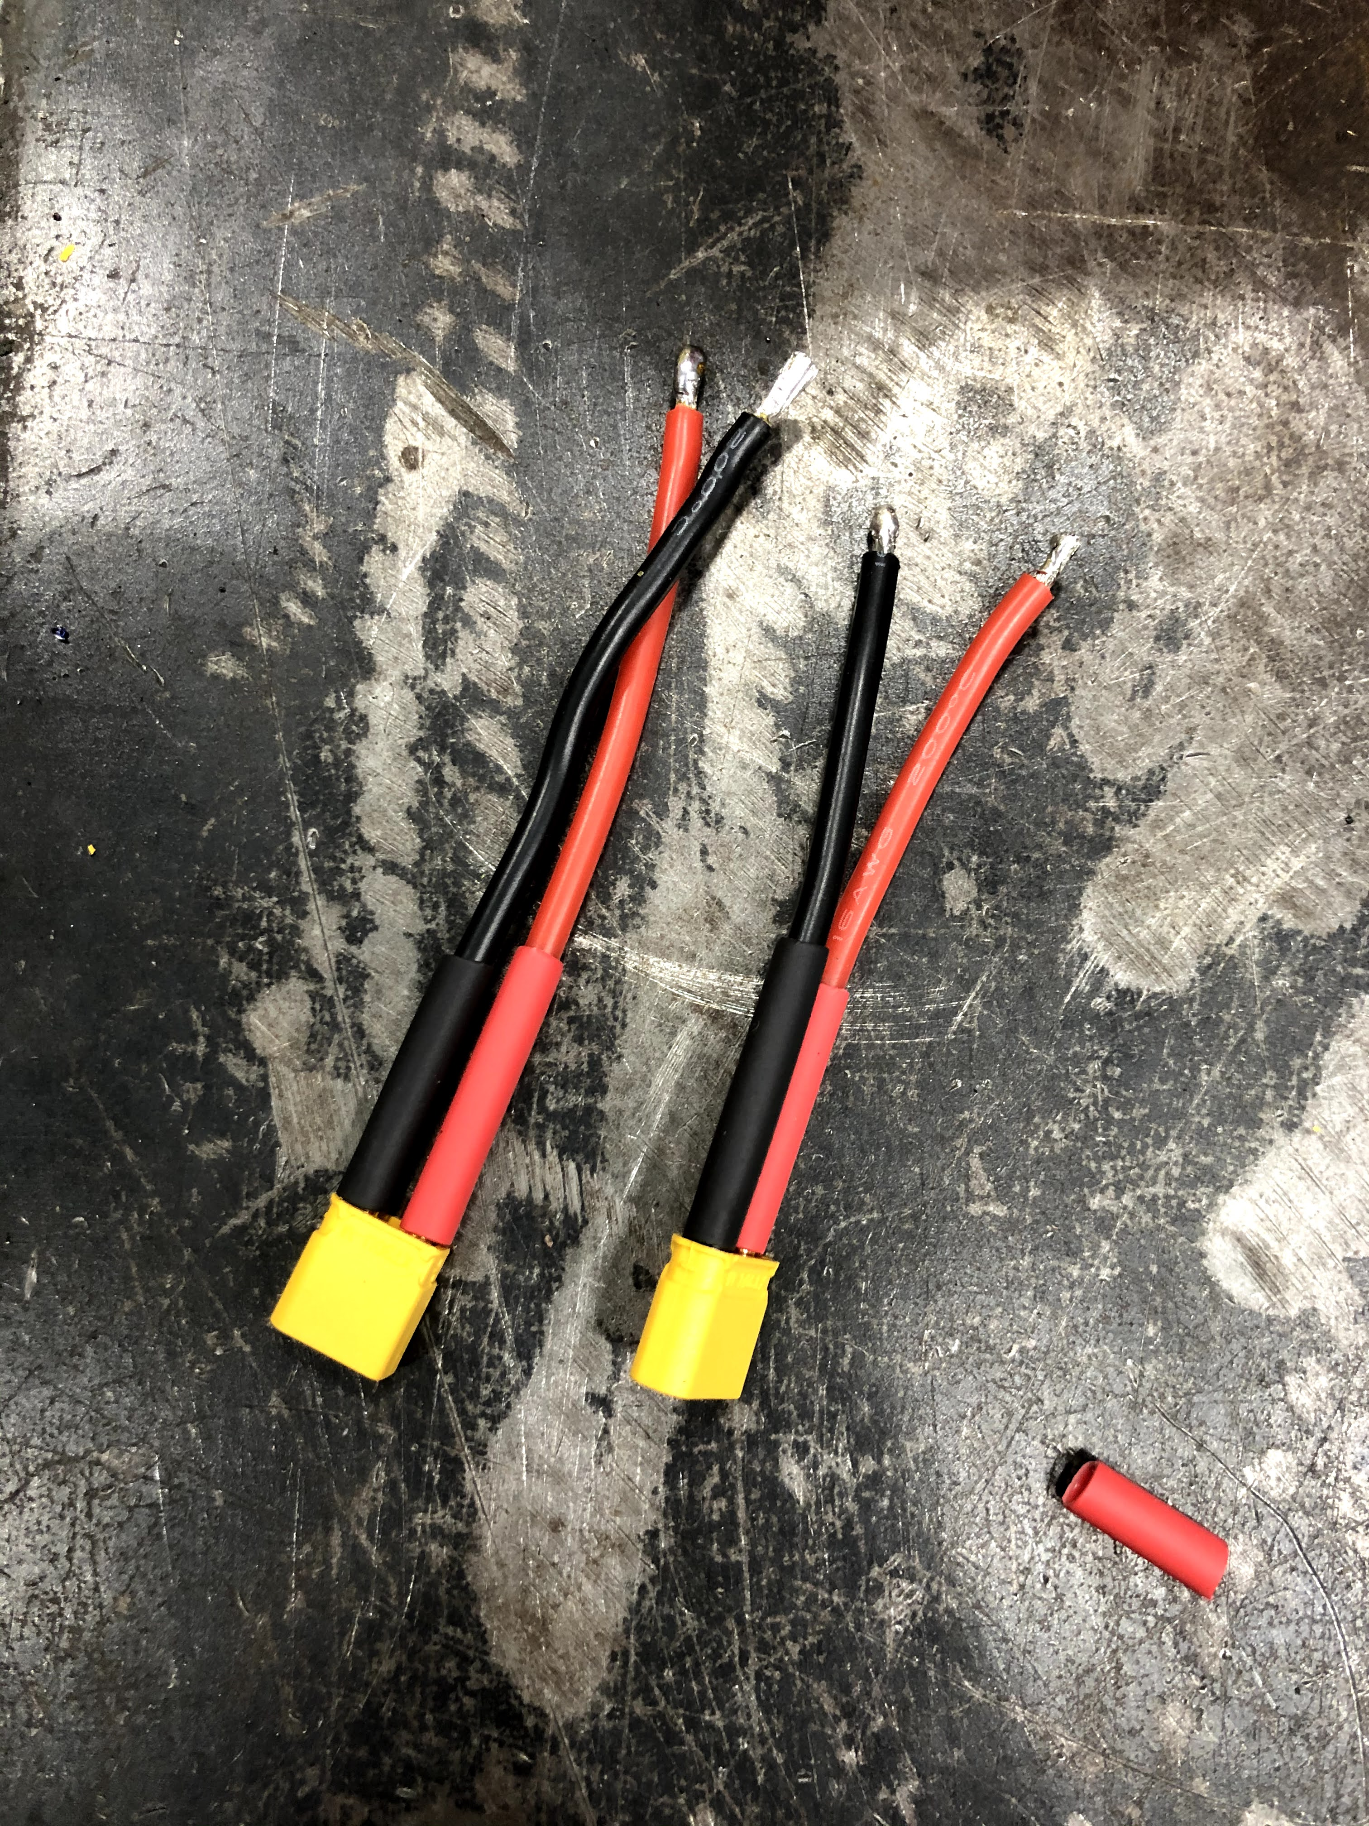
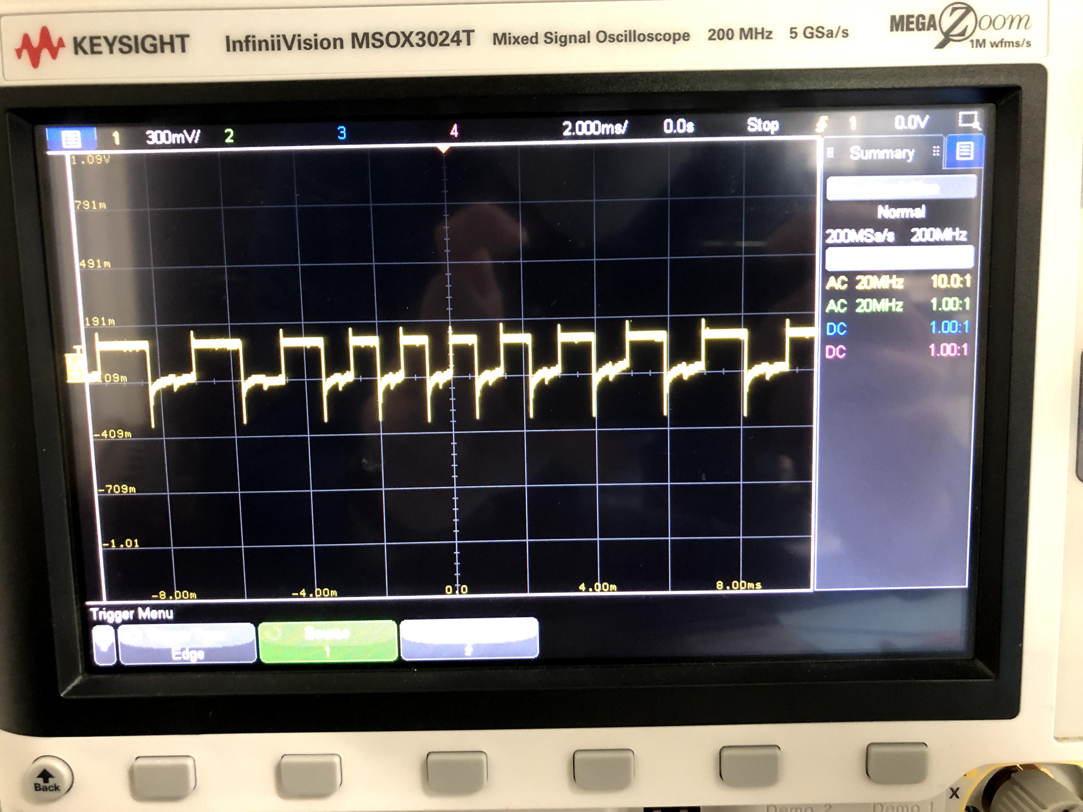
Electrical design
Design robust wiring and connection systems
Debug electrical systems that aren’t working properly

Slide 9
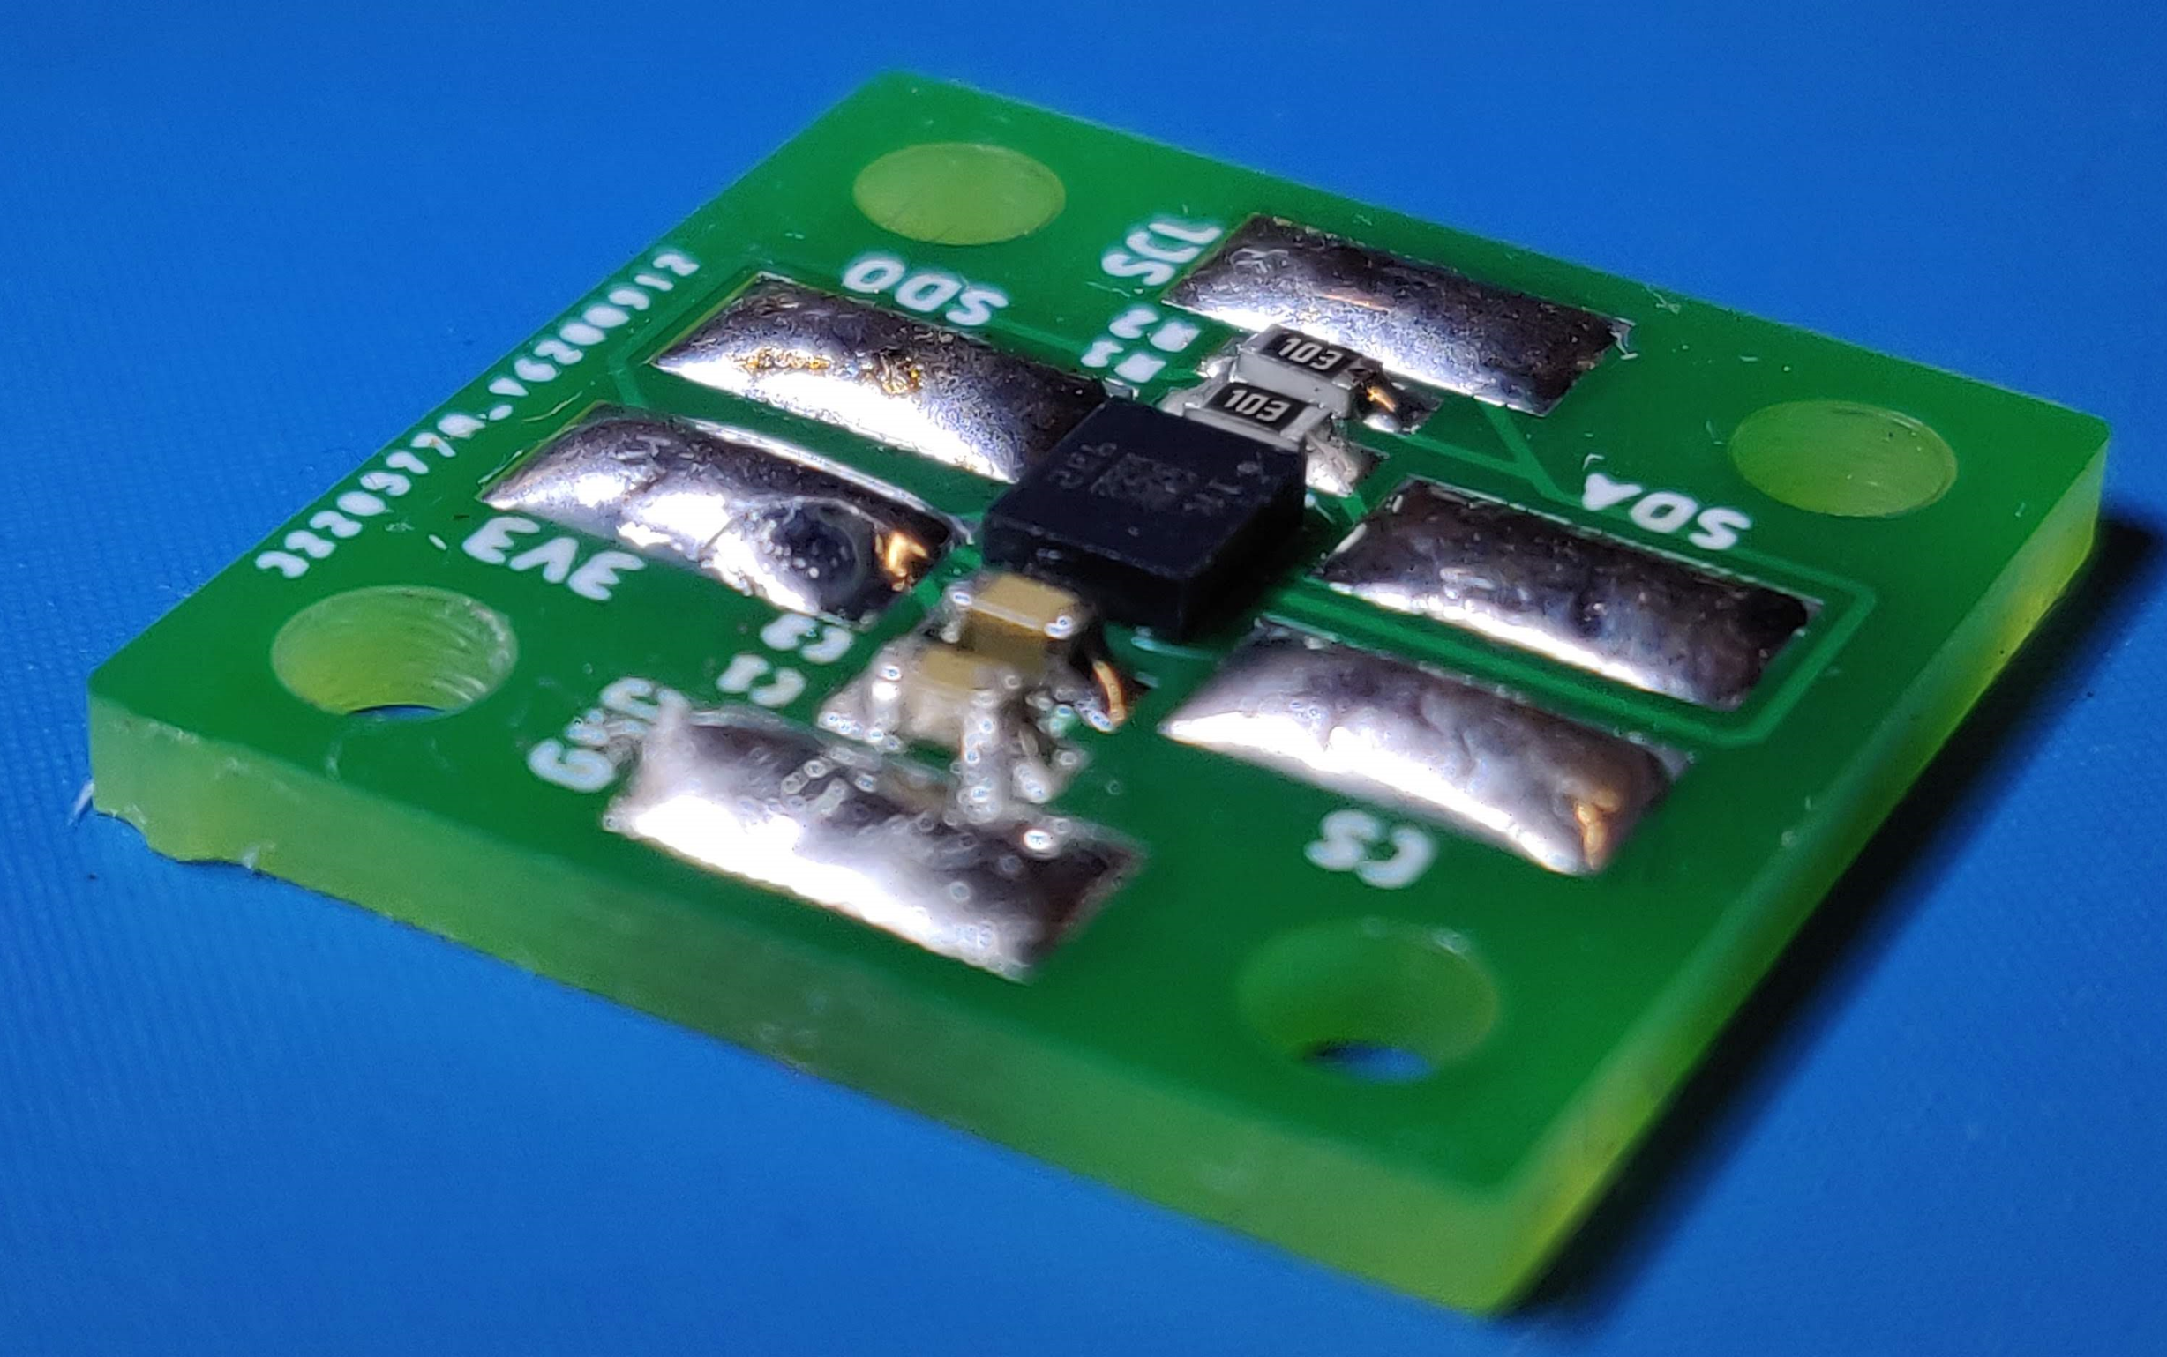
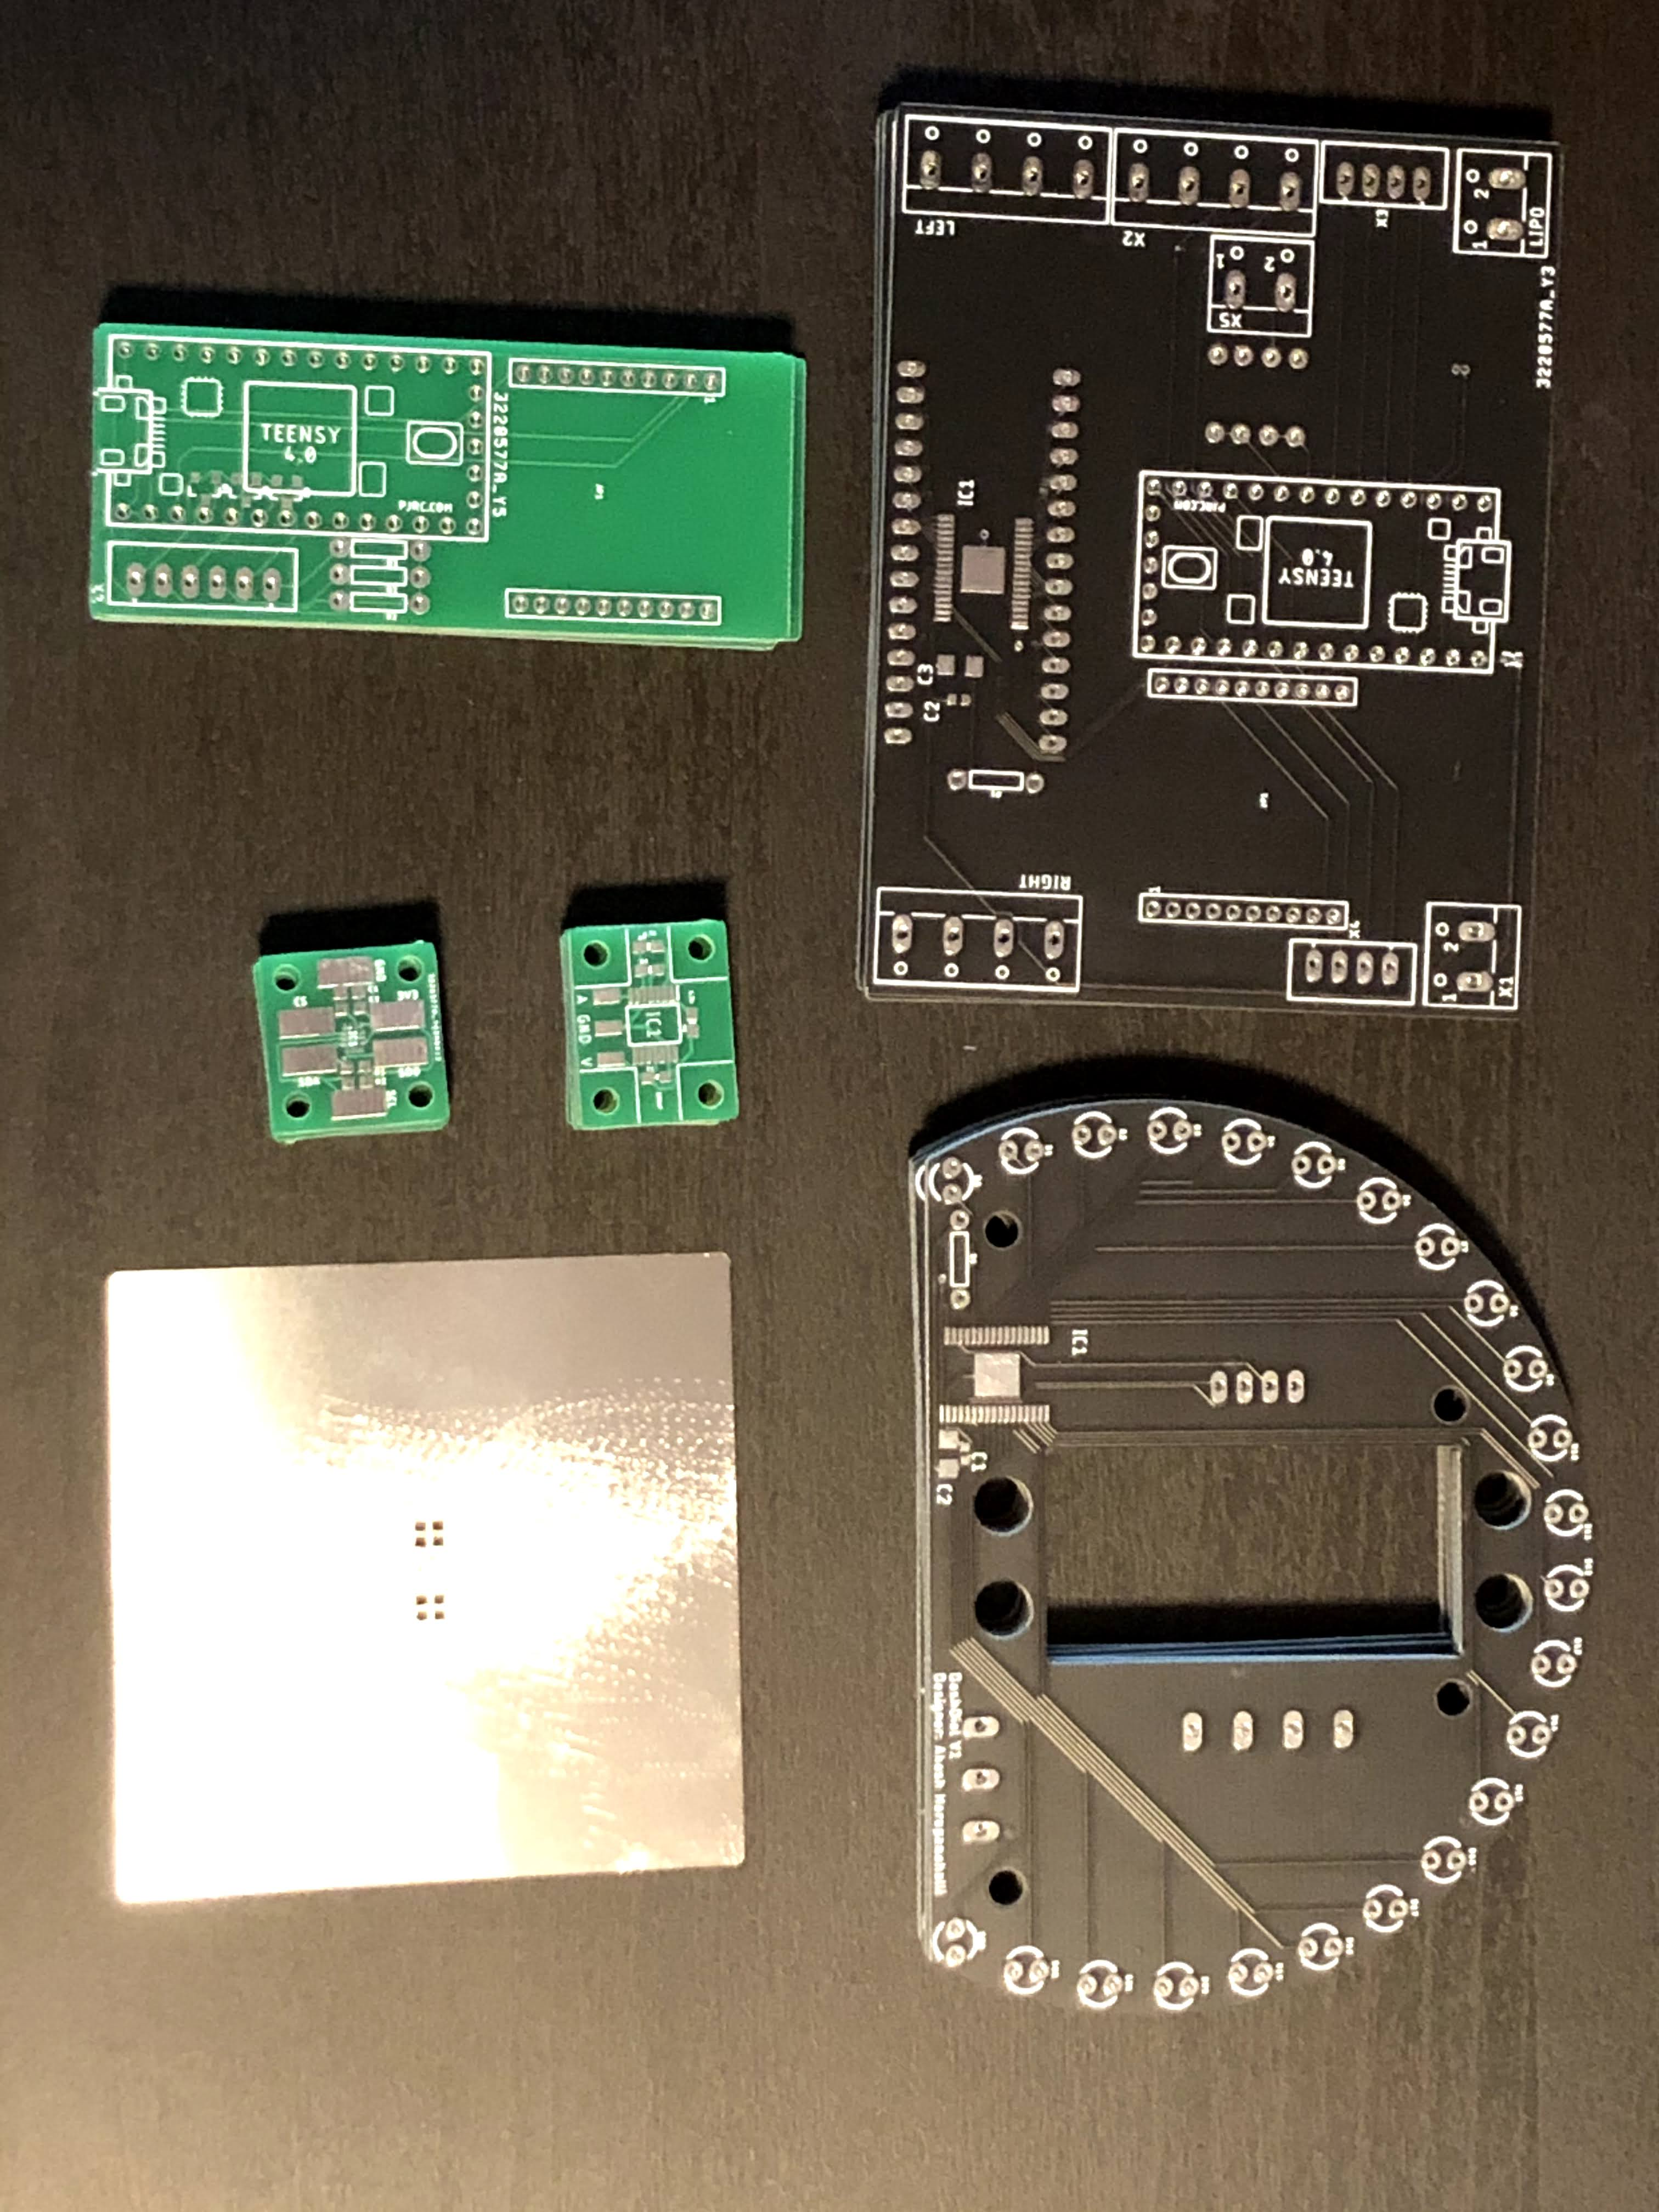
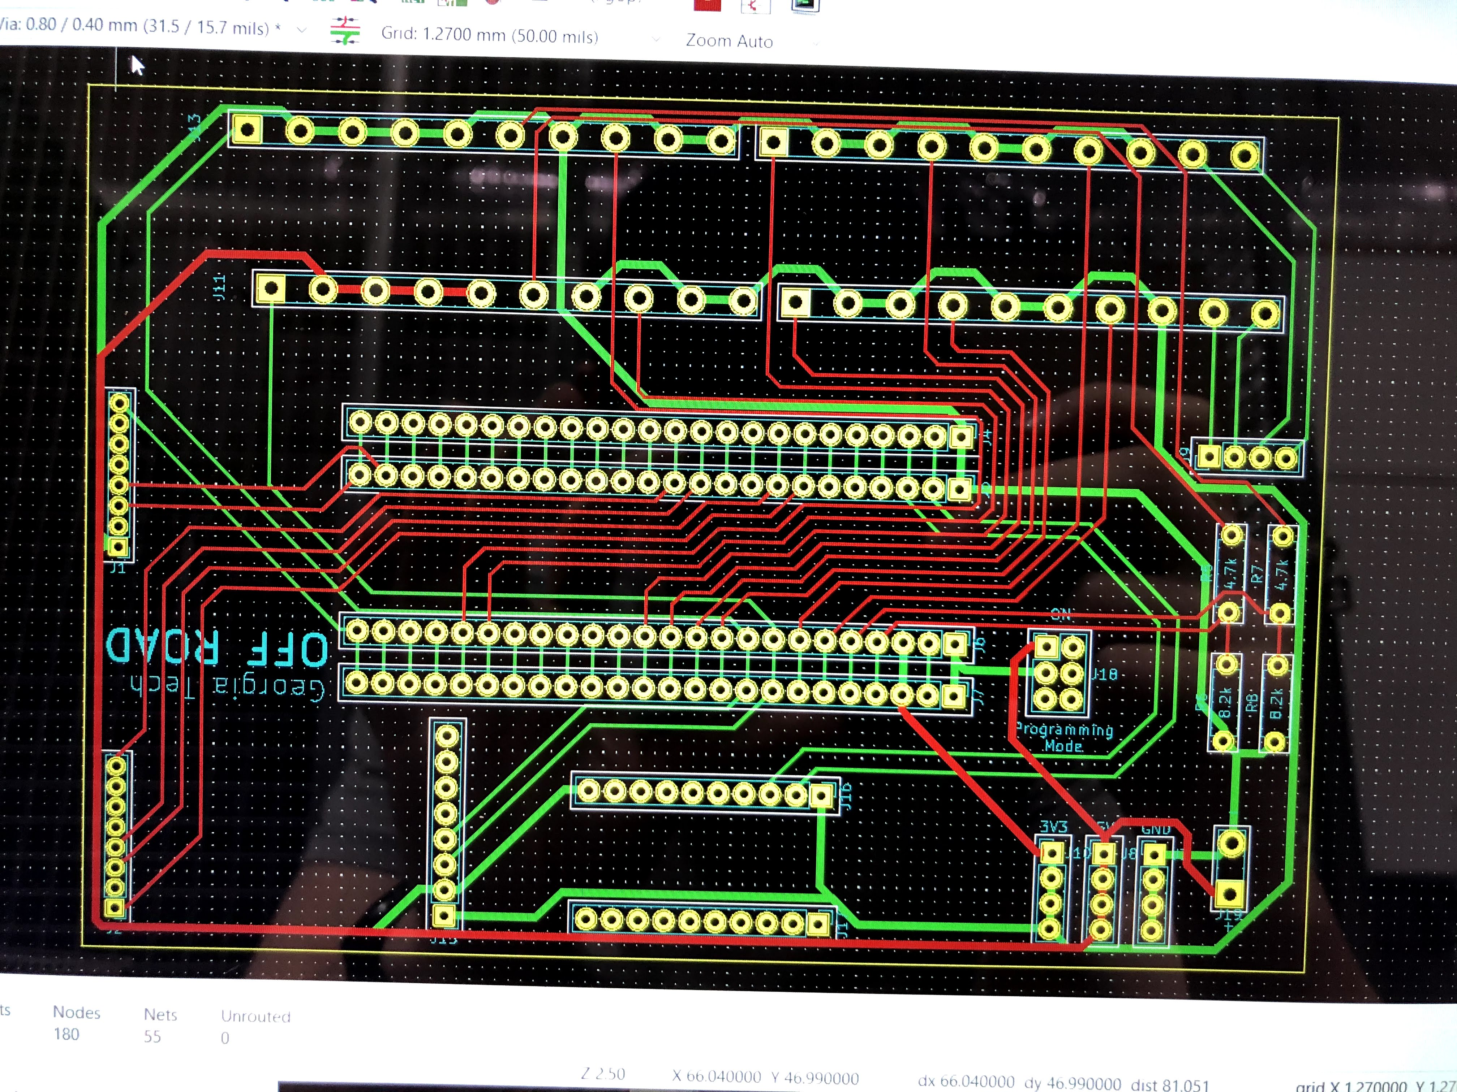
PCB design
Use industry standard EAGLE to design complex multi-signal PCB’s
Learn various design and signal conditioning techniques before learning in the classroom

Slide 10
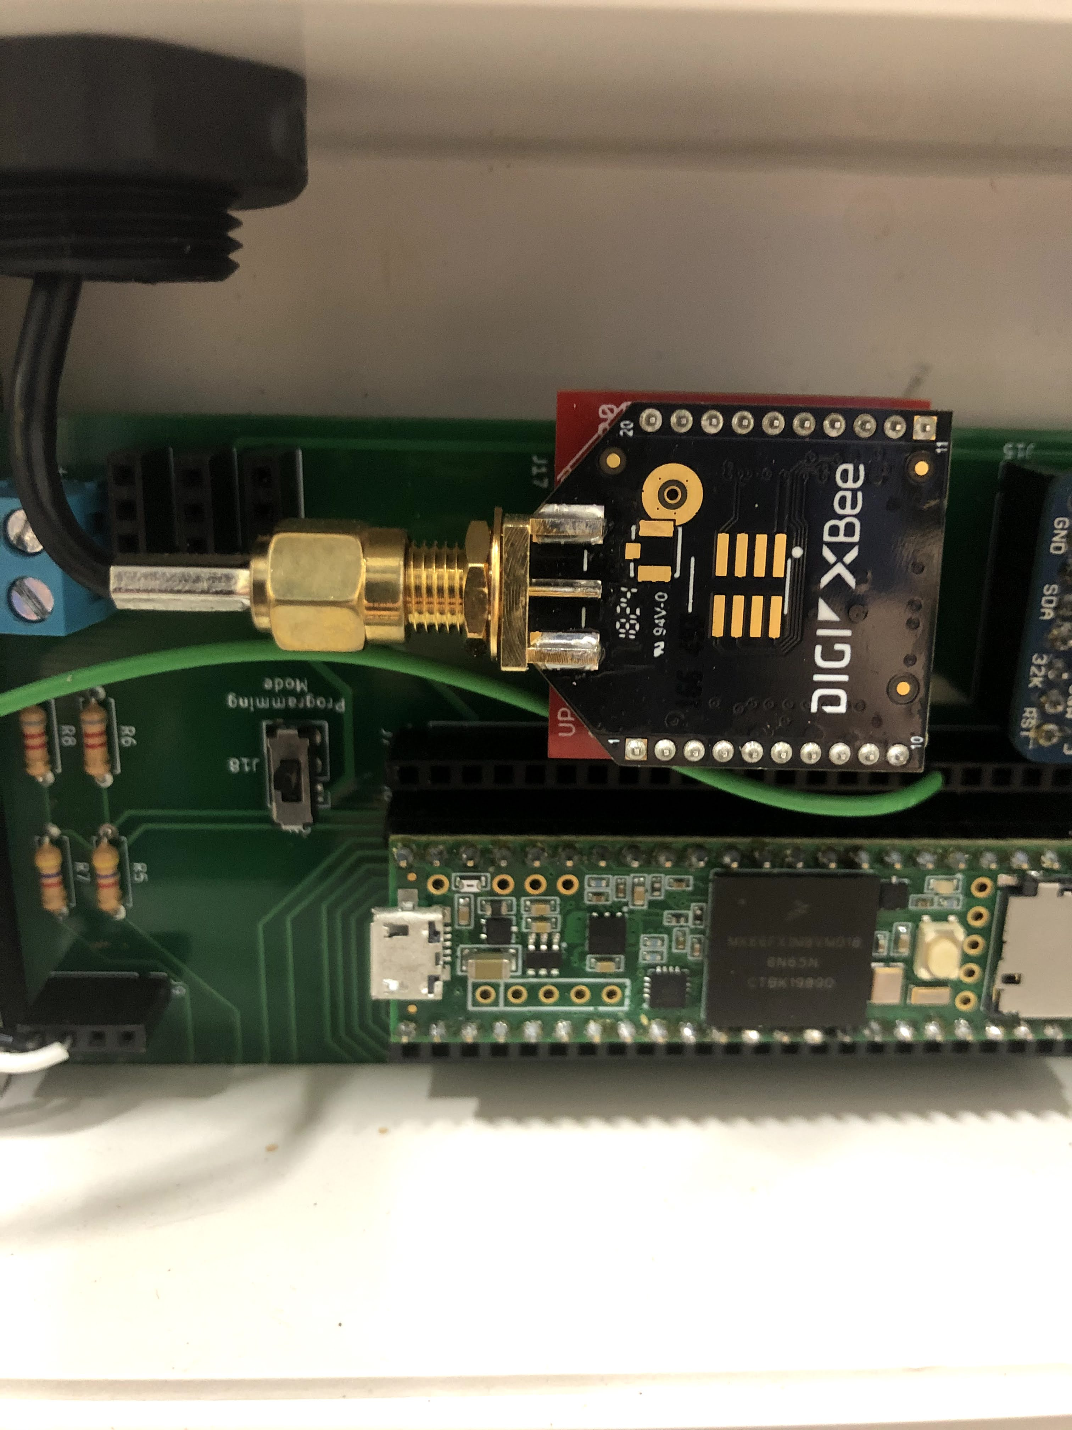
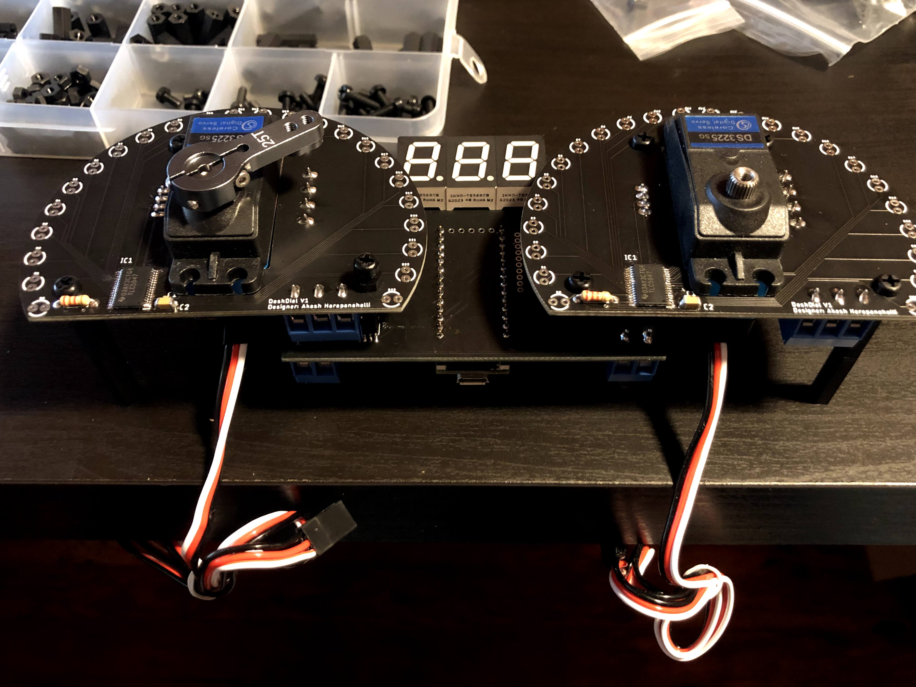
Embedded design (C++)
Design low level high speed software to collect lots of sensor data
Write control algorithms for projects such as the dashboard or testing rigs

Slide 11
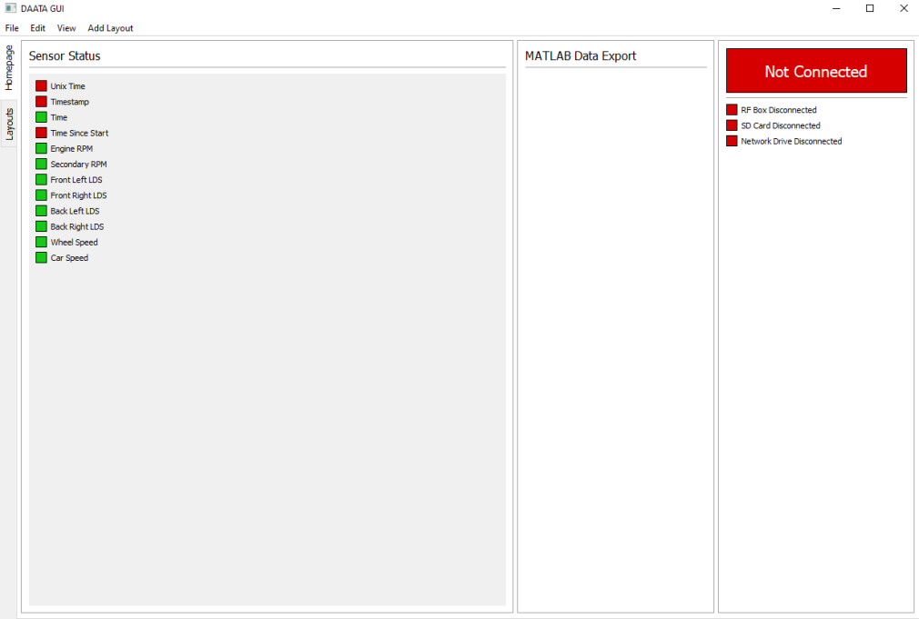
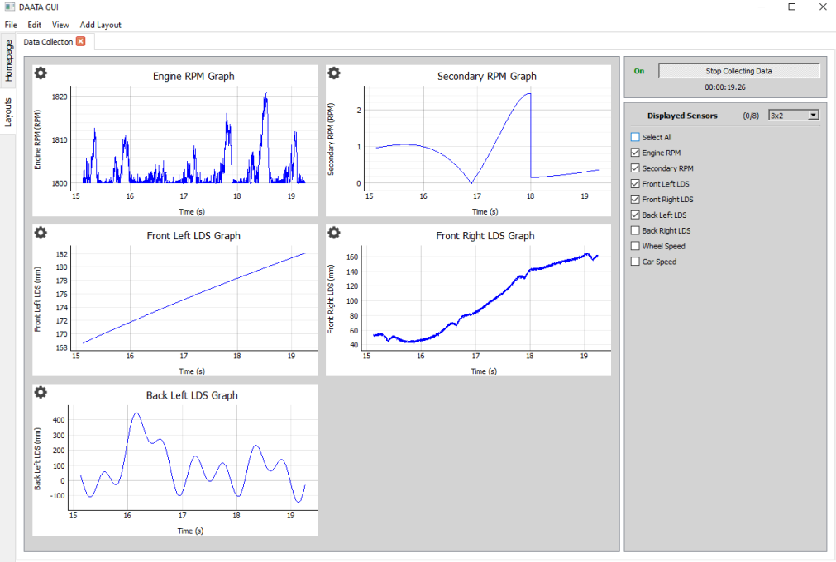
Software design (Python)
Write PC-side software for real time analysis of data
Learn standard application design workflows used in industry to be a successful contributing team member

Slide 12
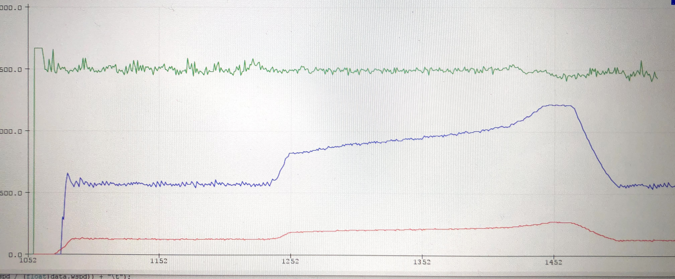
Data Analysis
Develop software for parsing data into something meaningful
Leverage datasets to find insights into data
Use different visualization techniques for data

Slide 13
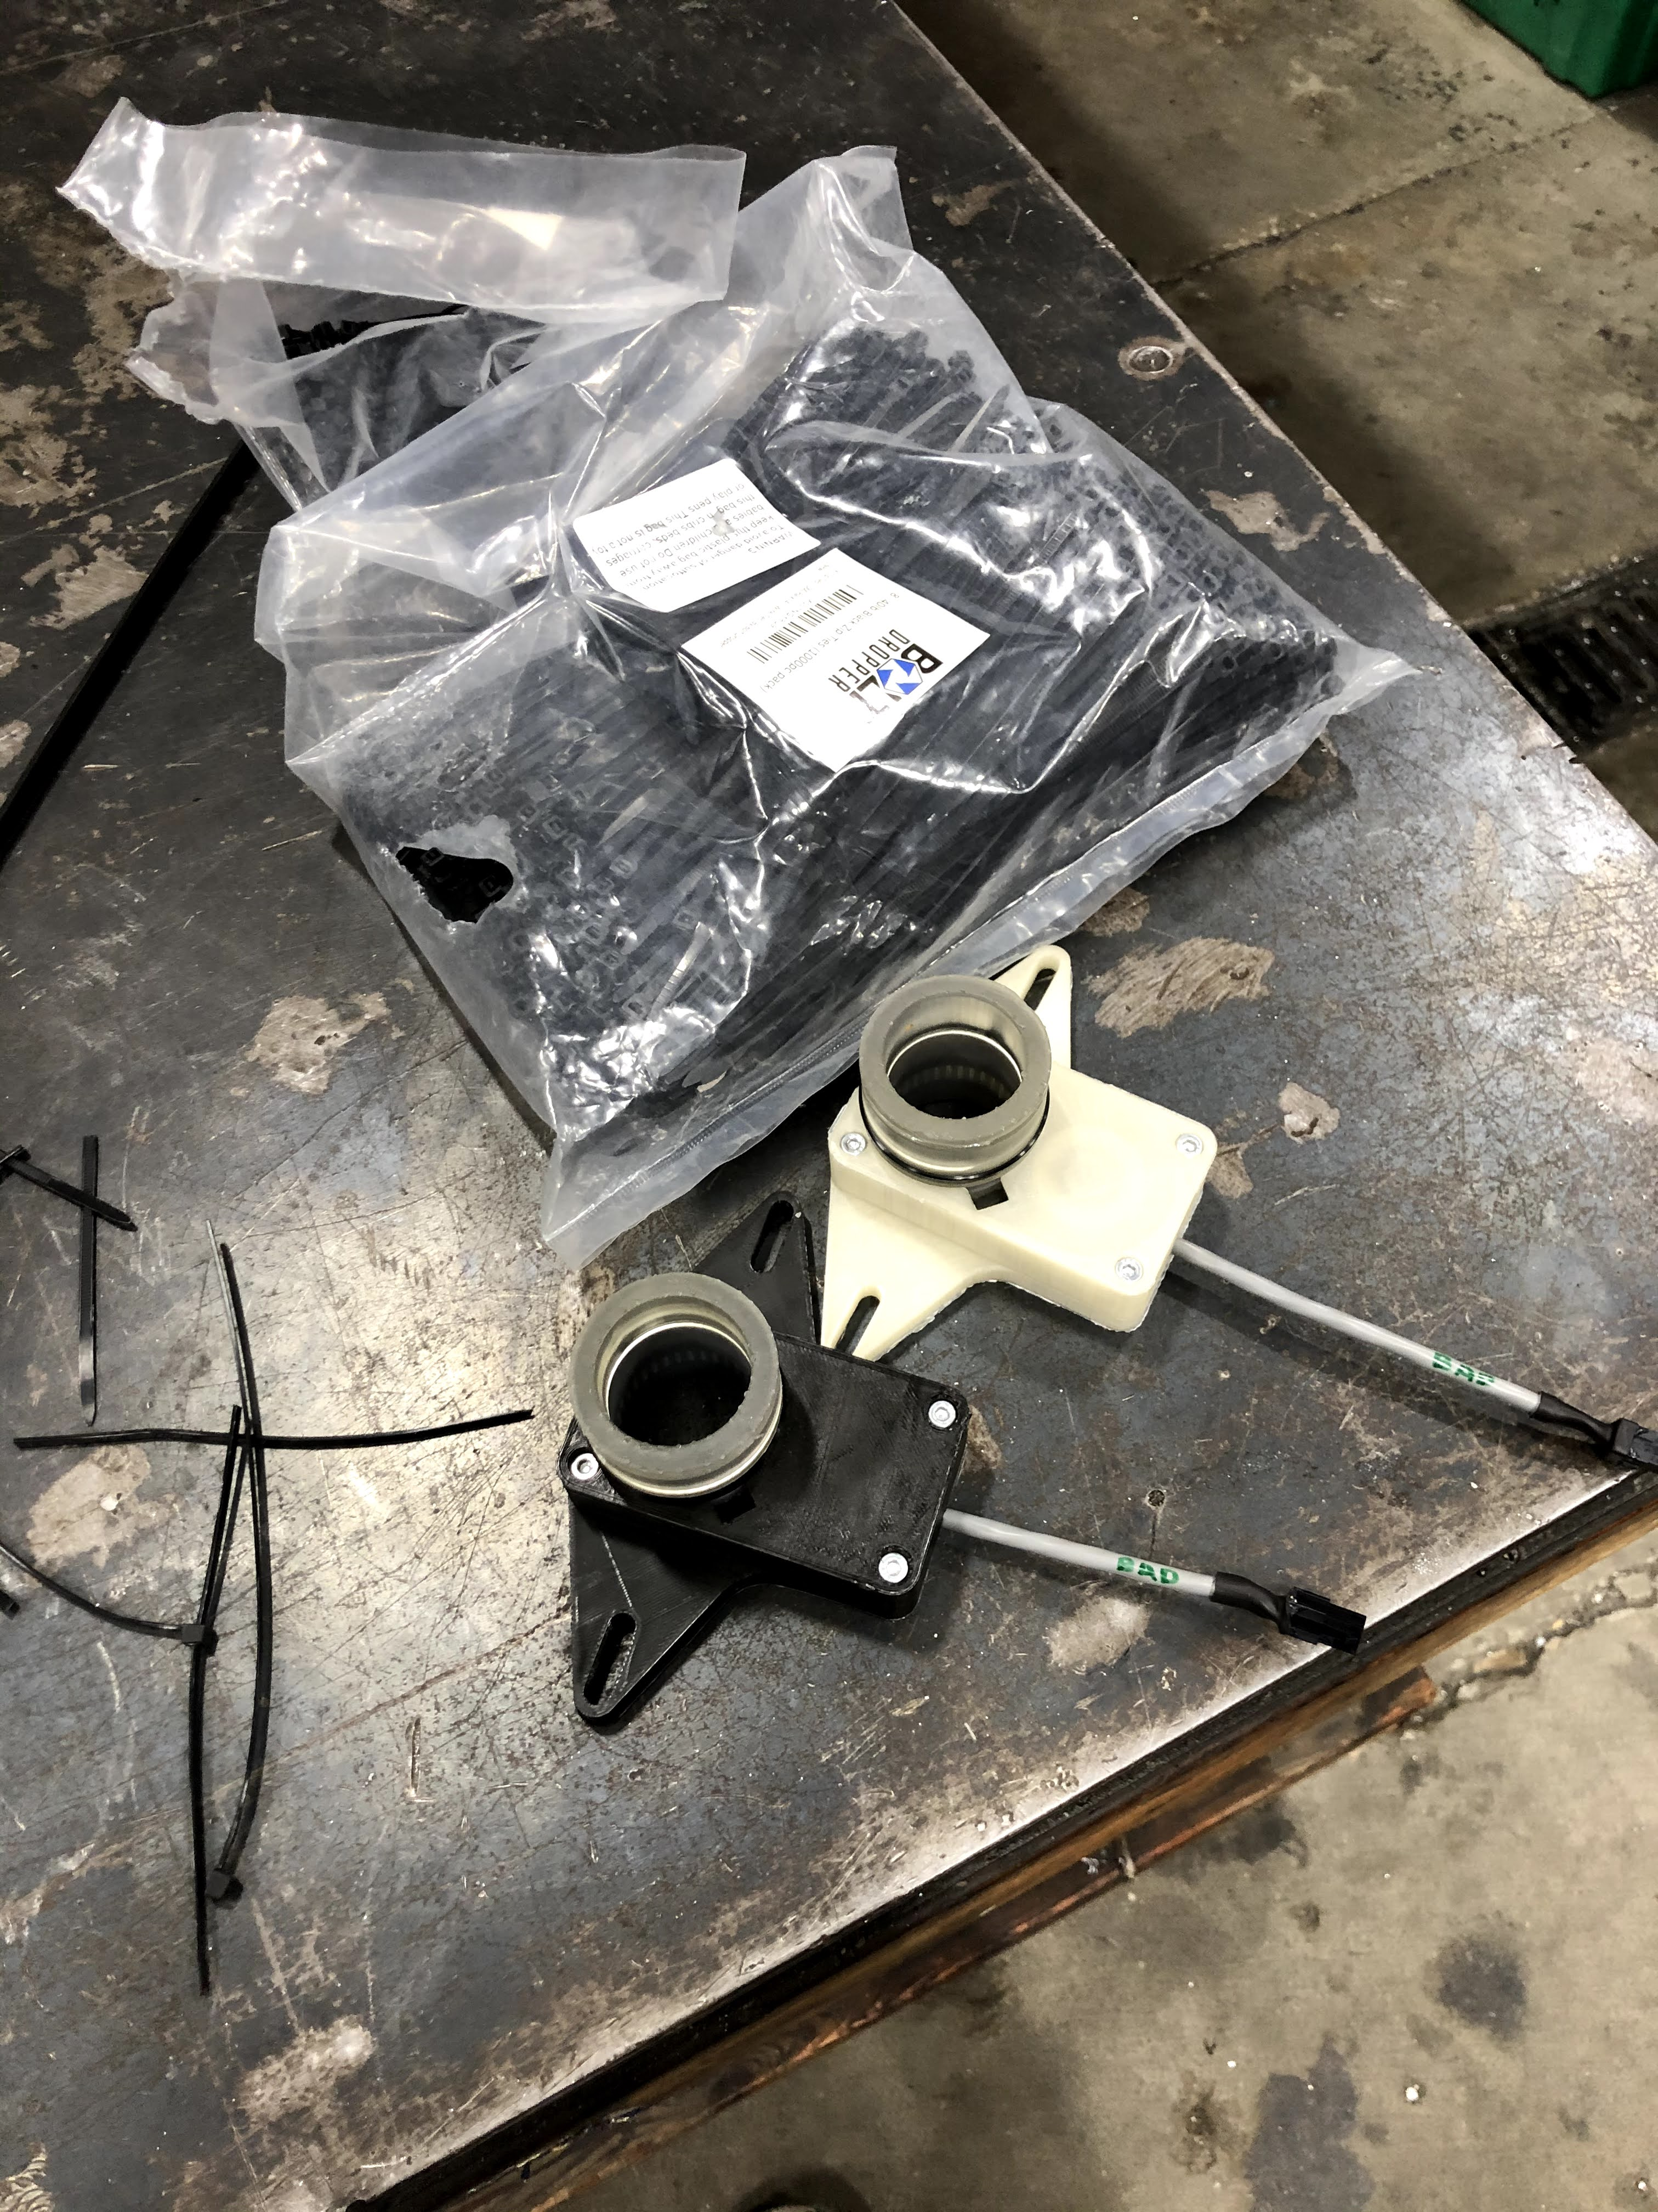
Enclosure design
Learn and practice design principles for robust and waterproof electronic enclosure design
Use CAD skills learned in the classroom for real world problems

Slide 14
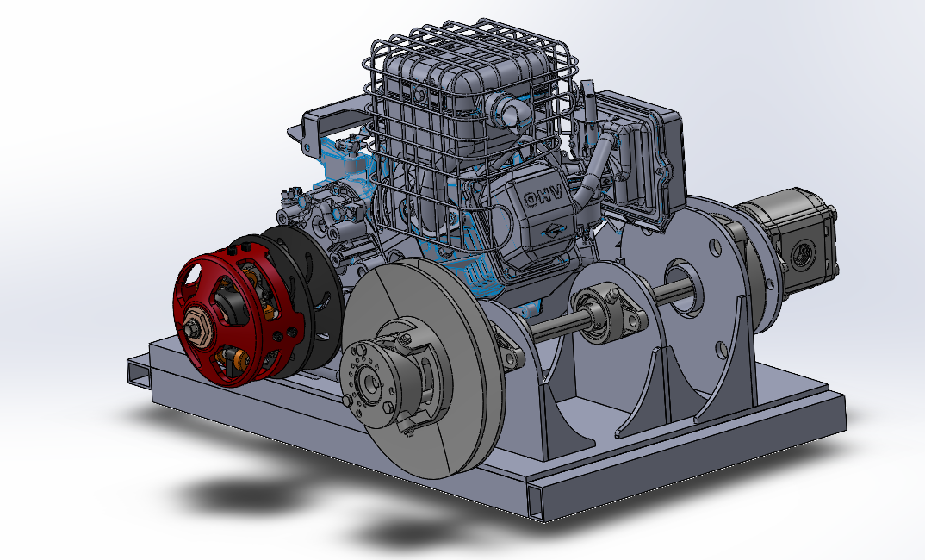
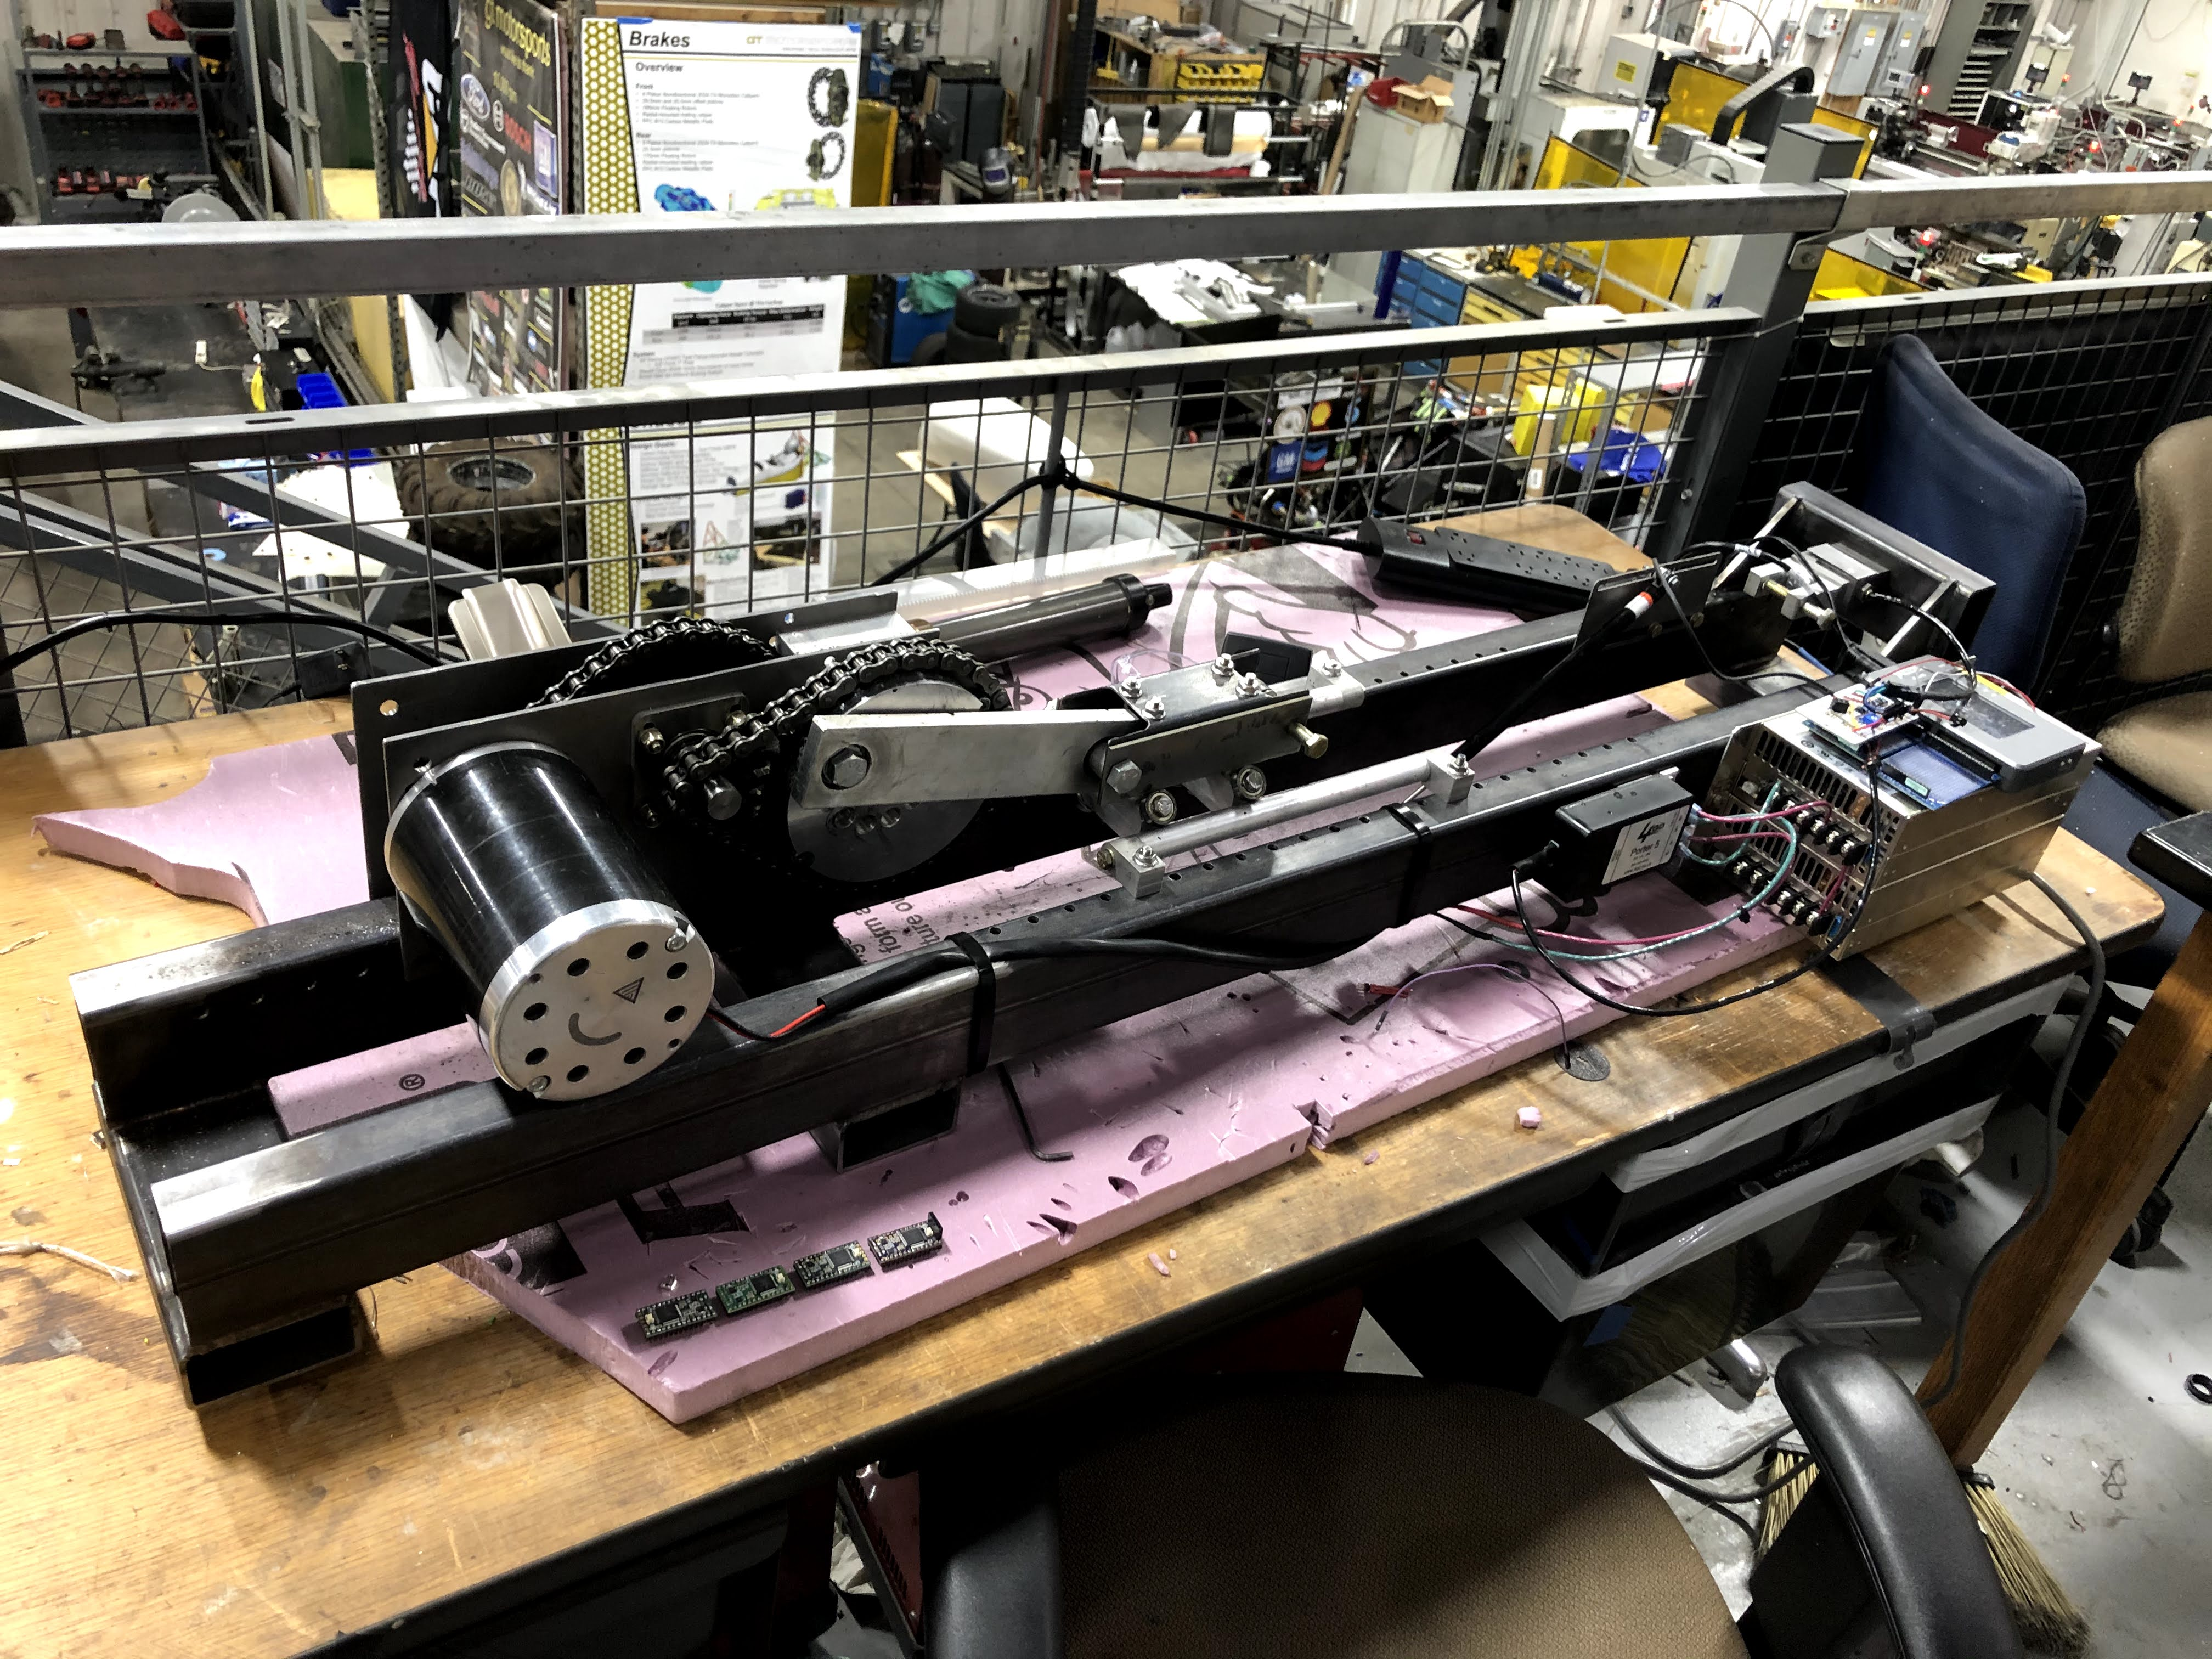
Testing rig design
Advanced CAD design to create testing rigs for subsystem performance characterization

Slide 15
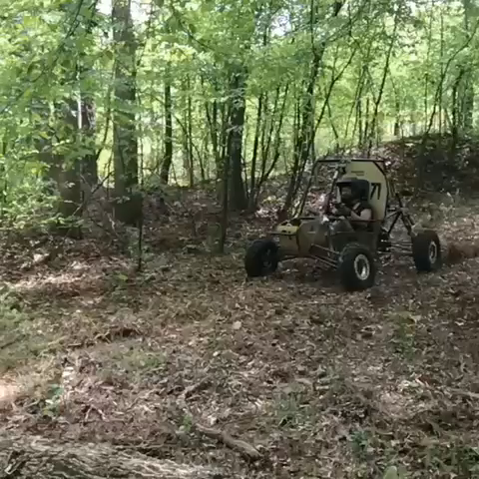
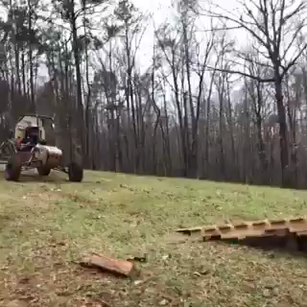
Destructive testing

Slide 16
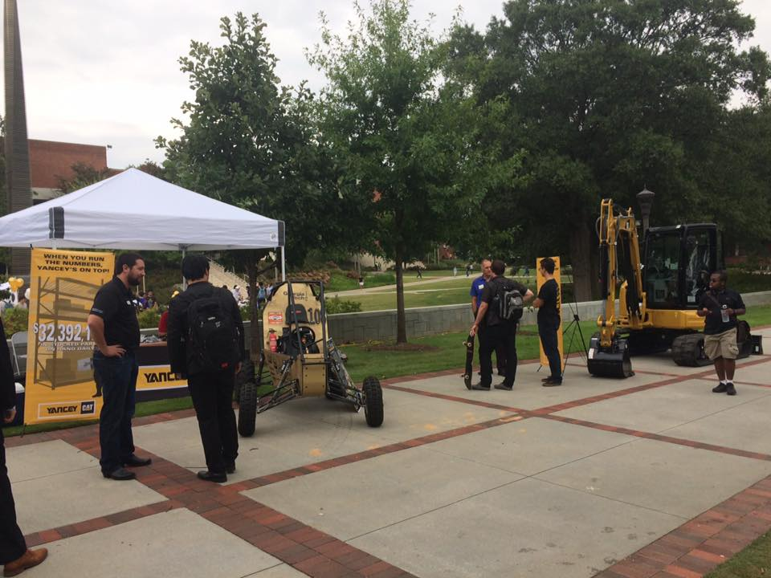








Why Join?
Real world experience not found in classes
Learn class material ahead of curriculum
High visibility to companies

Slide 17
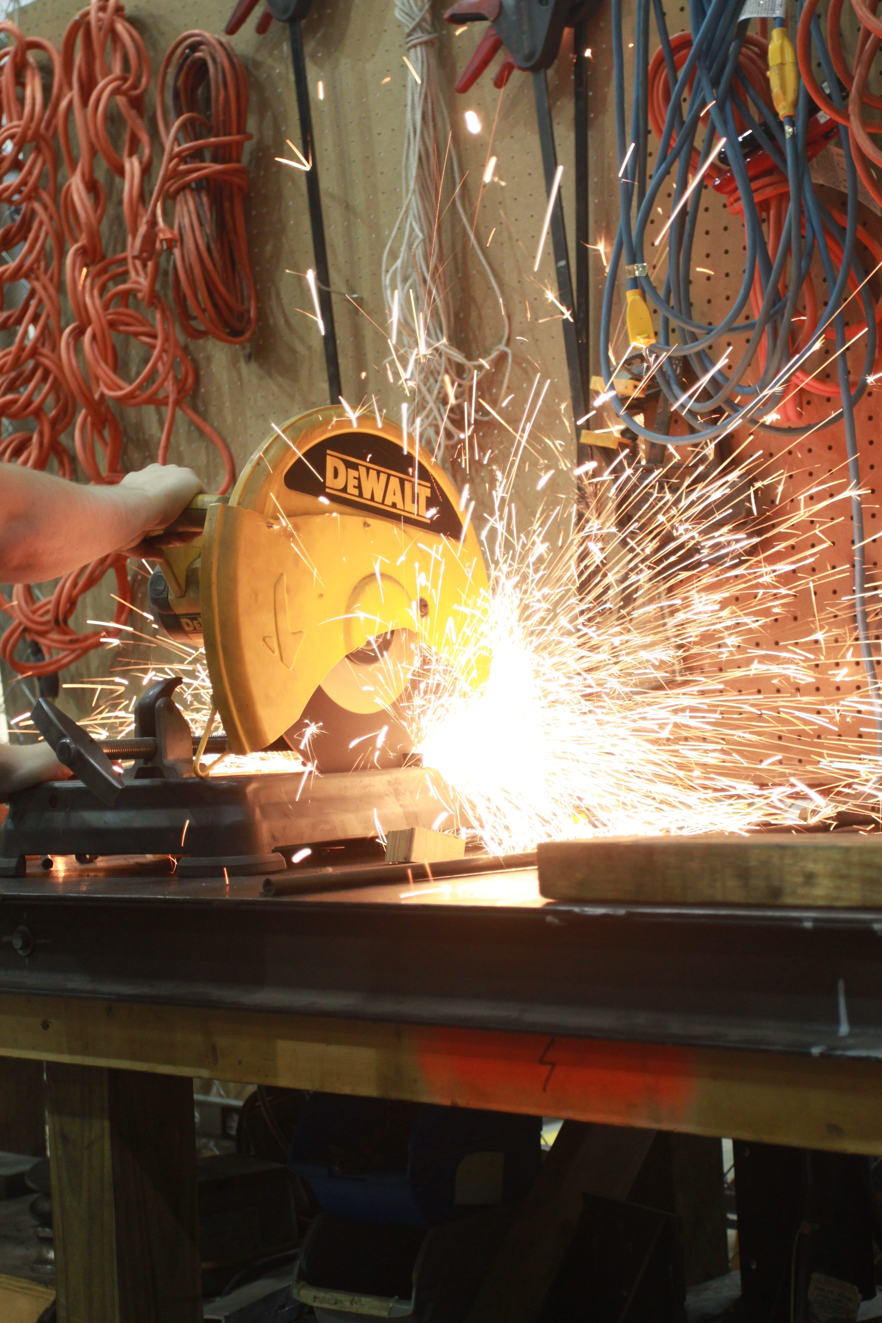
What happens if you join?
Classroom and hands-on training
Personalized plan
Doing meaningful work for team
Up to speed quick

Slide 18
When/where to meet?
Tuesdays, Thursday 7:30-10 PM Virtual Shop
Sundays 4-7 PM Virtual Shop
Student Competition Center: 575 14th Street (Can be reached by taking the green route)
SCC is access will be limited this semester

Slide 19
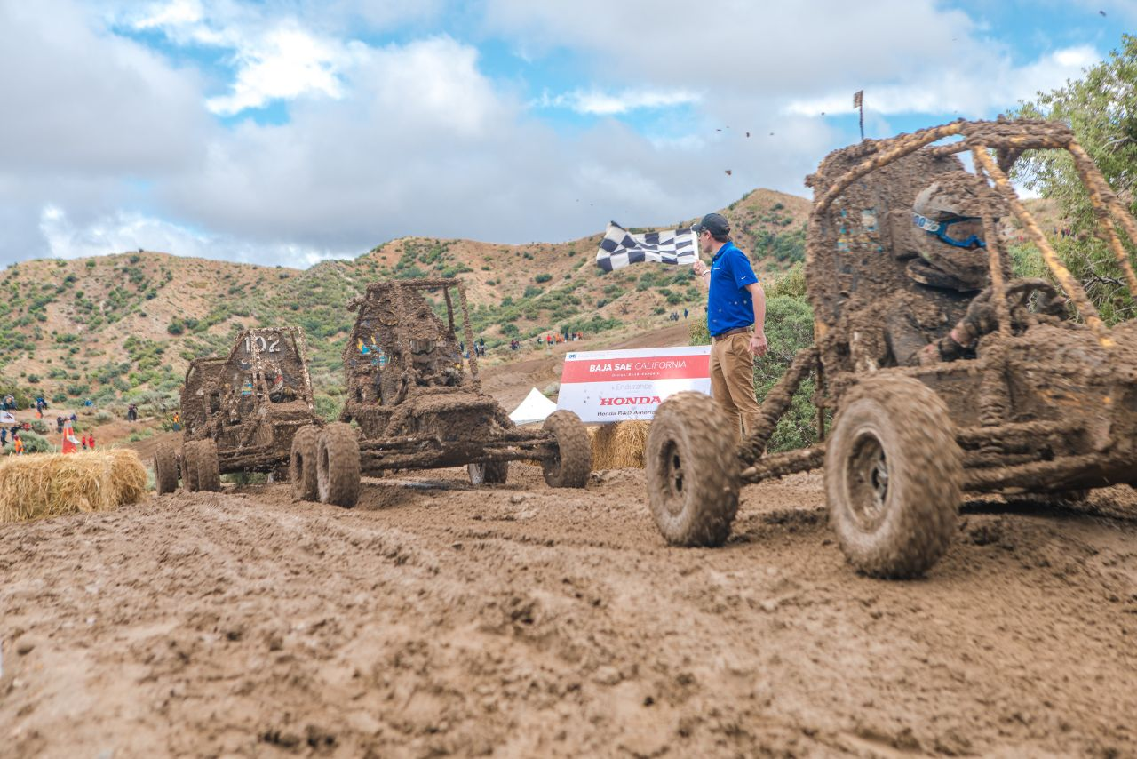
Commitment
At least 2 shop nights
6+ hours per week

Slide 20
Next Steps
Join slack: gtor.slack.com
Join new-member channel
Join the data_acquisition channel
Get the mobile app
View the new member guide

Slide 21
RECAP
What is GT Off-Road
What is Data Acquisition (DAQ)
What does DAQ do
What will I do in DAQ
What is expected of members in DAQ
How to join
Any questions?

